Slide 1
Chapter 1 The Foundations : Logic and Proofs Kenneth H. Rosen 7th edition
Section 1.6 :Rules of Inference

Slide 2
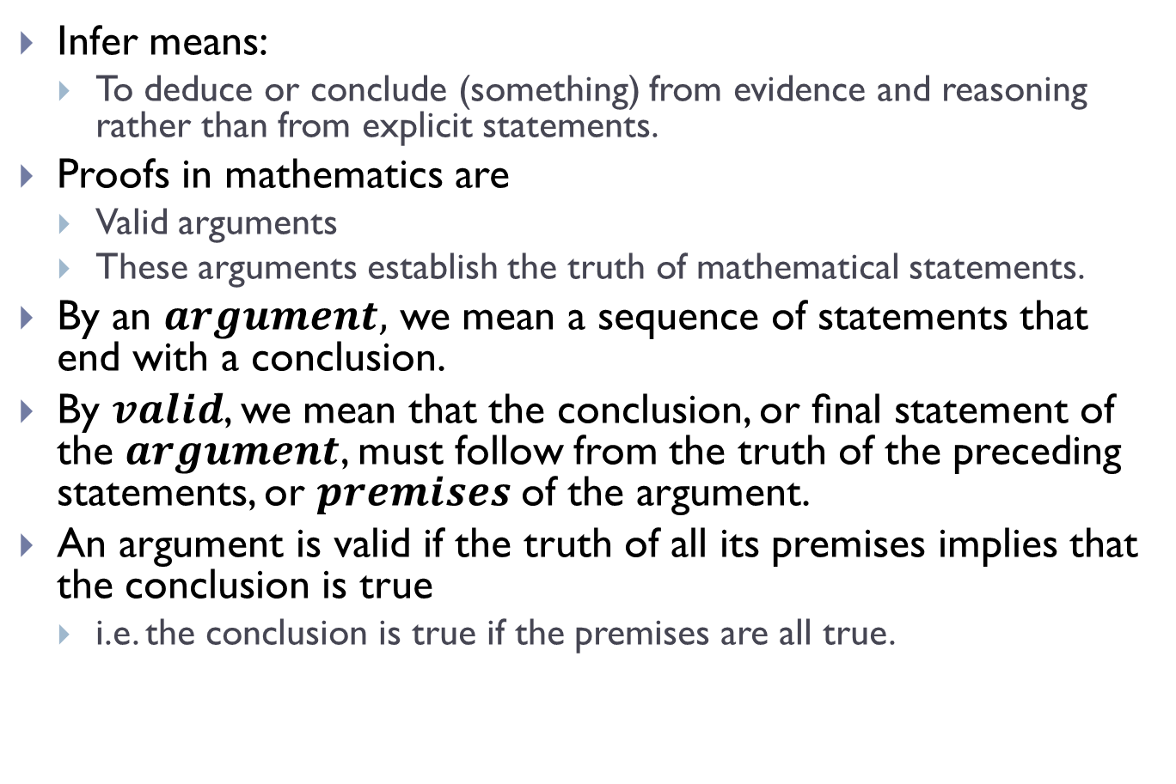
Rules of Inference
Infer means:
To deduce or conclude (something) from evidence and reasoning rather than from explicit statements.
Proofs in mathematics are
Valid arguments
These arguments establish the truth of mathematical statements.
By an $argument,$ we mean a sequence of statements that end with a conclusion.
By $valid$, we mean that the conclusion, or ﬁnal statement of the $argument$, must follow from the truth of the preceding statements, or $premises$of the argument.
An argument is valid if the truth of all its premises implies that the conclusion is true
i.e. the conclusion is true if the premises are all true.

Slide 3
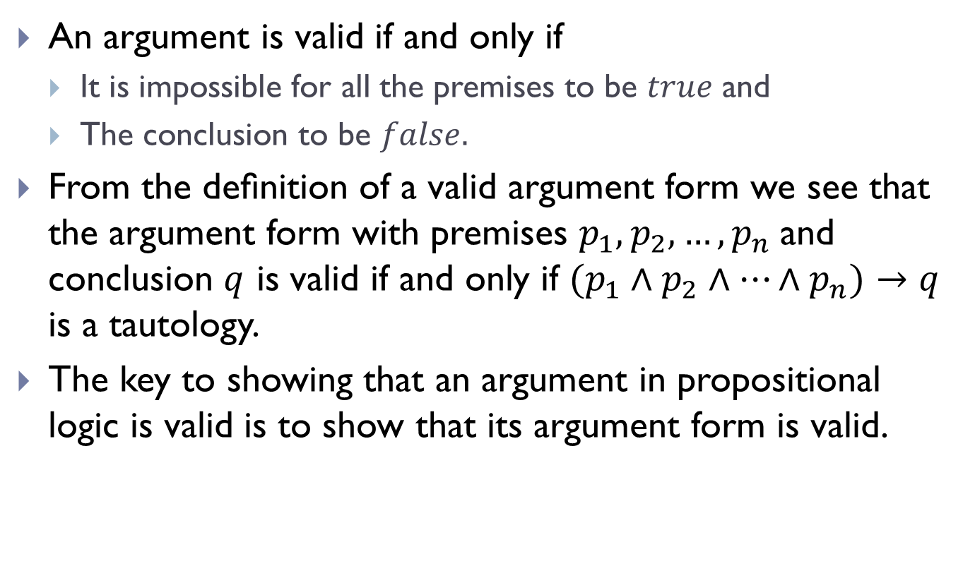
Rules of Inference(Contd.)
An argument is valid if and only if
It is impossible for all the premises to be $true$ and
The conclusion to be $false.$
From the deﬁnition of a valid argument form we see that the argument form with premises $p_{1},p_{2},…,p_{n}$and conclusion $q$ is valid if and only if $(p_{1}∧p_{2}∧…{∧p}_{n})→q$ is a tautology.
The key to showing that an argument in propositional logic is valid is to show that its argument form is valid.

Slide 4
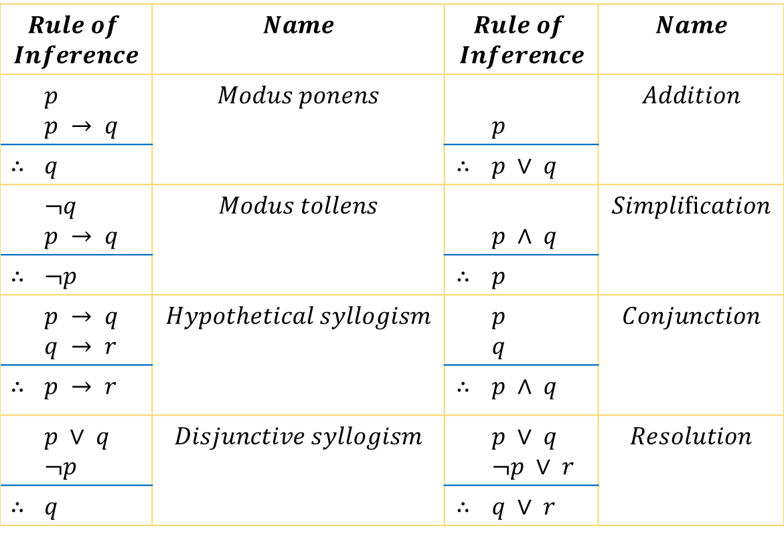
Rules of Inference(Contd.)
$$Rule of$$ $$Inference$$ |  | $$Name$$ | $$Rule of$$ $$Inference$$ |  | $$Name$$
 | $p$ $p → q$ | $$Modus ponens$$ |  | $p$ | $$Addition$$
$$∴$$ | $q$ |  | $$∴$$ | $p ∨ q$
 | $¬q$ $p → q$ | $$Modus tollens$$ |  | $p ∧ q$ | $$Simpliﬁcation$$
$$∴$$ | $¬p$ |  | $$∴$$ | $p$
 | $p → q$ $q → r$ | $$Hypothetical syllogism$$ |  | $p$ $q$ | $$Conjunction$$
$$∴$$ | $p → r$ |  | $$∴$$ | $p ∧ q$
 | $p ∨ q$ $¬p$ | $$Disjunctive syllogism$$ |  | $p ∨ q$ $¬p ∨ r$ | $$Resolution$$
∴ | $q$ |  | $$∴$$ | $q ∨ r$

Slide 5
Rules of Inference(Contd.)
An Illustration:
Consider the following argument:
“If you have a current password, then you can log onto the network.”
“You have a current password.”
Therefore,
“You can log onto the network.”

Slide 6
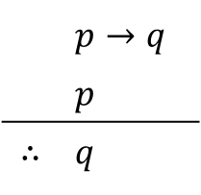
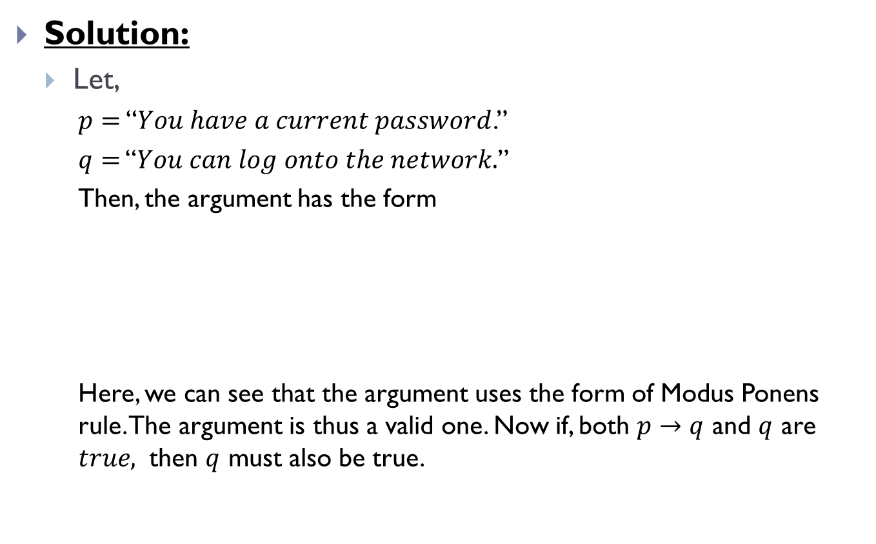
Rules of Inference(Contd.)
Solution:
Let,
$p=$ “$You have a current password$.”
$q=$ “$You can log onto the network.$”
Then, the argument has the form
Here, we can see that the argument uses the form of Modus Ponens rule. The argument is thus a valid one. Now if, both $p→q$ and $q$ are $true,$ then $q$ must also be true.
 | $p→q$
 | $p$
$$∴$$ | $q$

Slide 7


Rules of Inference(Contd.)
What if, you have two premises, $p→q$ and $q$ and the conclusion as $q$ where, not both of the premises are true?

Slide 8
Rules of Inference(Contd.)
An Illustration:
Consider the following argument:
“If you have access to the network, then you can change your grades.”
“You have access to the network.”
Therefore,
“You can change your grades.”

Slide 9
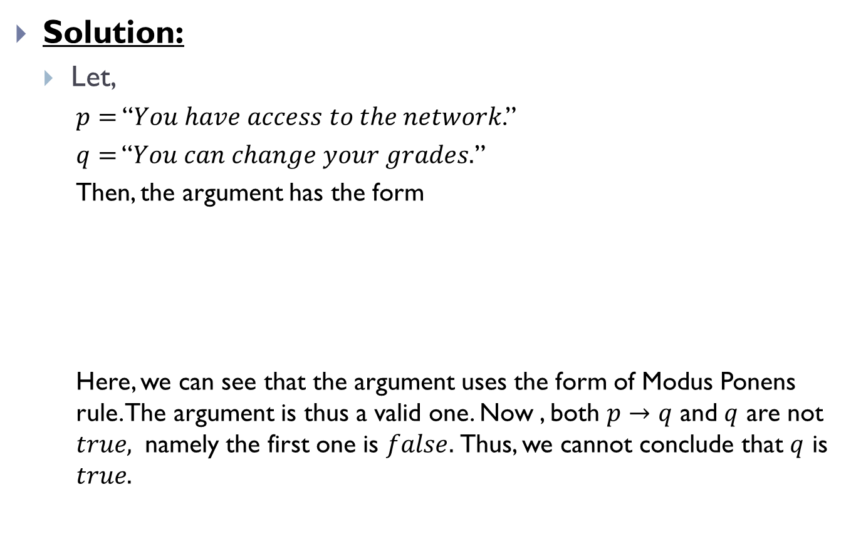
Rules of Inference(Contd.)
Solution:
Let,
$p=$ “$You have access to the network$.”
$q=$ “$You can change your grades.$”
Then, the argument has the form
Here, we can see that the argument uses the form of Modus Ponens rule. The argument is thus a valid one. Now , both $p→q$ and $q$ are not $true,$ namely the first one is $false.$Thus, we cannot conclude that $q$ is $true.$
 | $p→q$
 | $p$
$$∴$$ | $q$

Slide 10
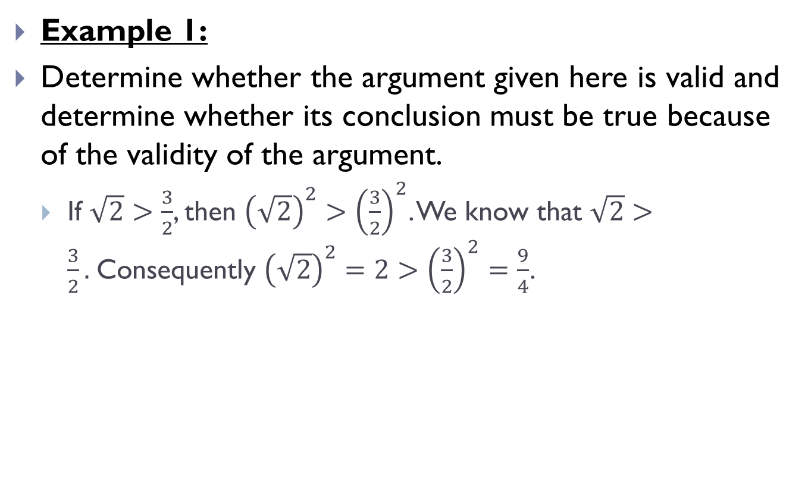
Rules of Inference(Contd.)
Example 1:
Determine whether the argument given here is valid and determine whether its conclusion must be true because of the validity of the argument.
If $\sqrt{2}>\frac{3}{2}$, then ${\left(\sqrt{2}\right)}^{2}>{\left(\frac{3}{2}\right)}^{2}$. We know that $\sqrt{2}>\frac{3}{2}.$Consequently ${\left(\sqrt{2}\right)}^{2}=2>{\left(\frac{3}{2}\right)}^{2}=\frac{9}{4}$.

Slide 11
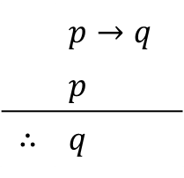
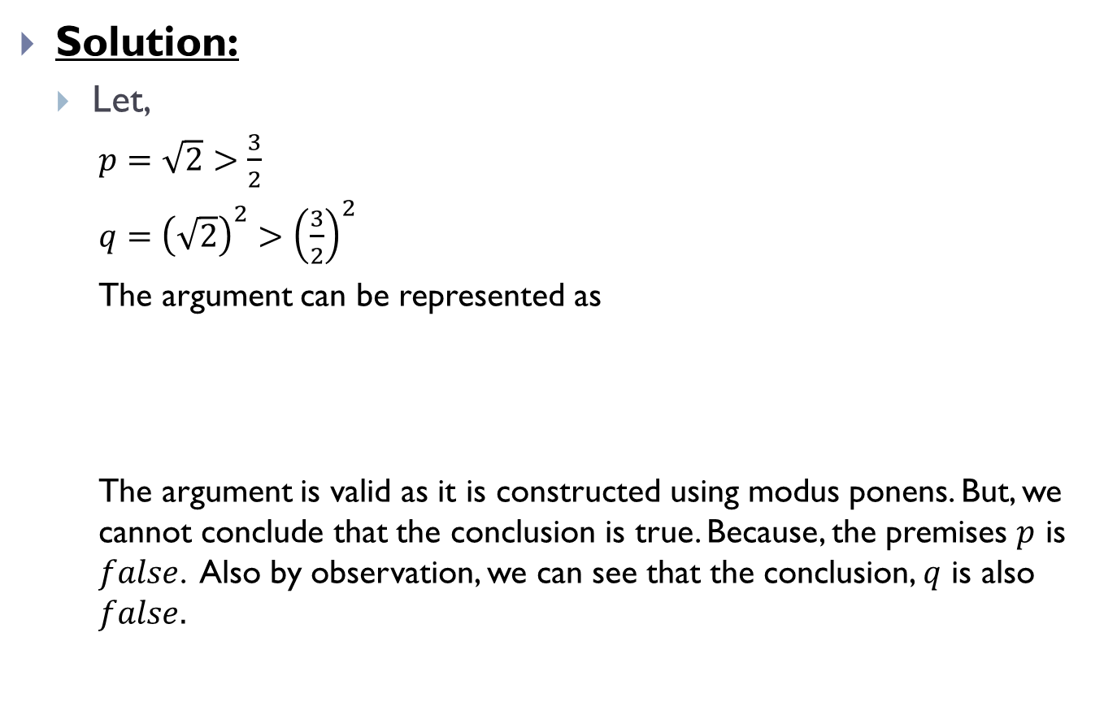
Rules of Inference(Contd.)
Solution:
Let,
$p=$ $\sqrt{2}>\frac{3}{2}$
$q=$ ${\left(\sqrt{2}\right)}^{2}>{\left(\frac{3}{2}\right)}^{2}$
The argument can be represented as
The argument is valid as it is constructed using modus ponens. But, we cannot conclude that the conclusion is true. Because, the premises $p$ is $false$. Also by observation, we can see that the conclusion, $q$ is also $false.$
 | $p→q$
 | $p$
$$∴$$ | $q$

Slide 12
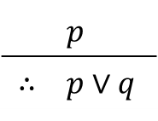
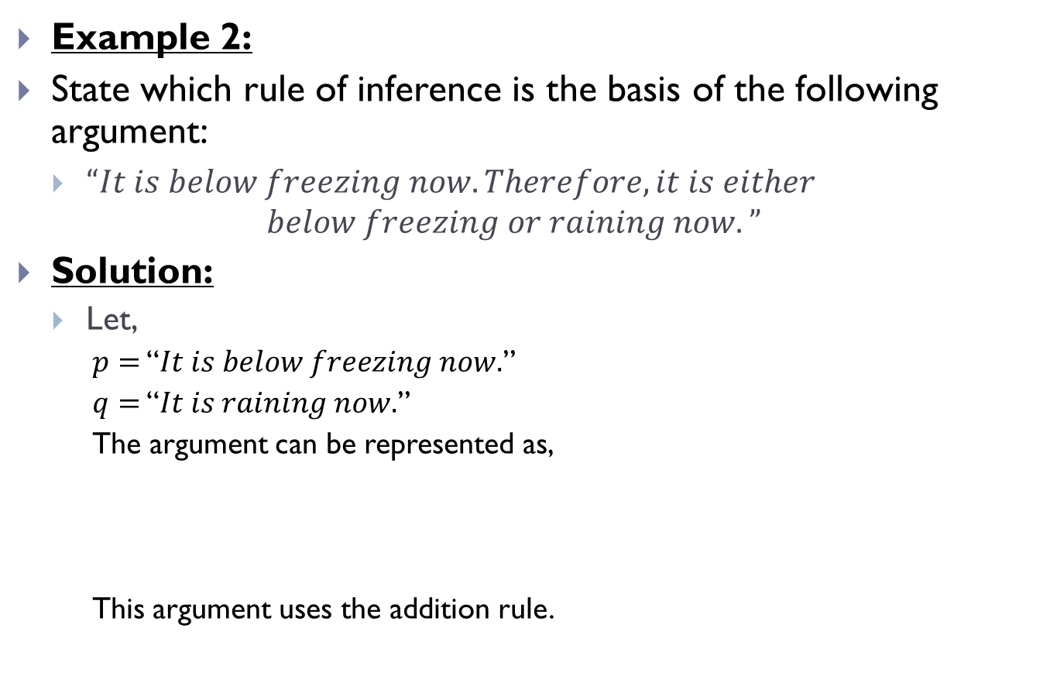
Rules of Inference(Contd.)
Example 2:
State which rule of inference is the basis of the following argument:
$“It is below freezing now. Therefore, it is either$
$$below freezing or raining now.”$$
Solution:
Let,
$p=$ “$It is below freezing now.$”
$q=$ “$It is raining now.$”
The argument can be represented as,
This argument uses the addition rule.
 | $p$
$$∴$$ | $p∨q$

Slide 13
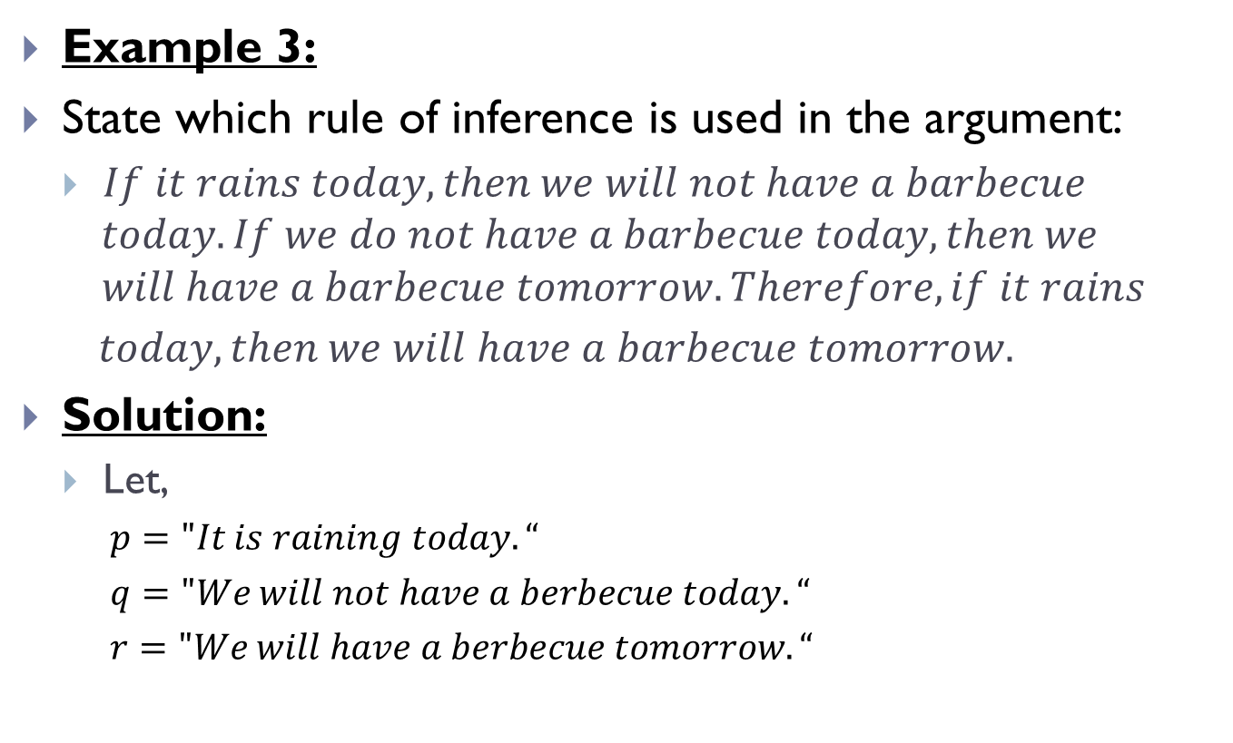
Rules of Inference(Contd.)
Example 3:
State which rule of inference is used in the argument:
$If it rains today, then we will not have a barbecue$
$$today. If we do not have a barbecue today, then we$$
$$will have a barbecue tomorrow. Therefore, if it rains$$
$today, then we will have a barbecue tomorrow.$
Solution:
Let,
$p="It is raining today.“$
$q="We will not have a berbecue today.“$
$r="We will have a berbecue tomorrow.“$

Slide 14
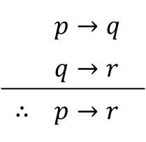
Rules of Inference(Contd.)
The argument can be represented as,
The argument thus uses the hypothetical syllogism rule.
 | $p→q$
 | $q→r$
$$∴$$ | $p→r$

Slide 15
Using Rules of Inference to Build Arguments
Example 1:
Show that the premises
“It is not sunny this afternoon and it is colder than yesterday,”
“We will go swimming only if it is sunny,”
“If we do not go swimming, then we will take a canoe trip,”
“If we take a canoe trip, then we will be home by sunset”
Lead to the conclusion
“We will be home by sunset.”

Slide 16
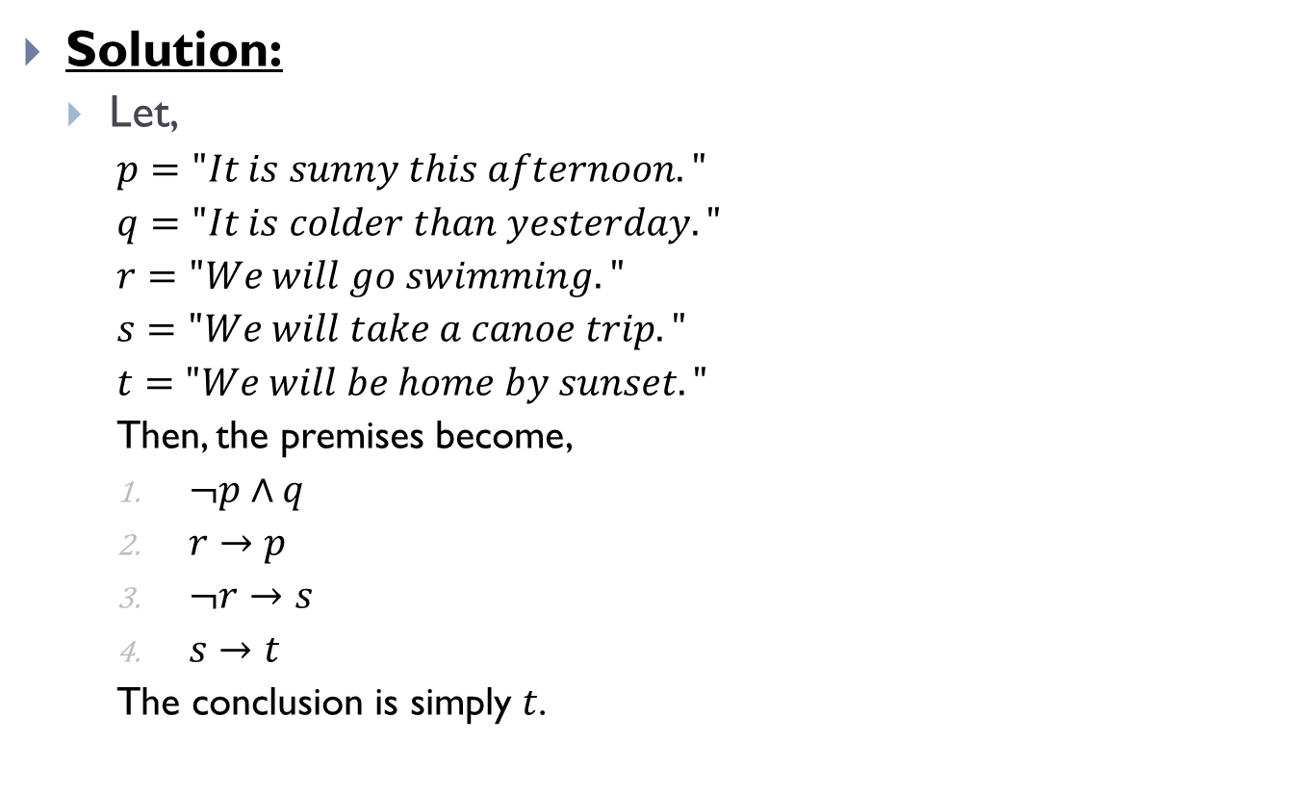
Using Rules of Inference to Build Arguments(Contd.)
Solution:
Let,
$p="It is sunny this afternoon."$
$q="It is colder than yesterday."$
$r="We will go swimming."$
$s="We will take a canoe trip."$
$t="We will be home by sunset."$
Then, the premises become,
$¬p∧q$
$r→p$
$¬r→s$
$s→t$
The conclusion is simply $t$.

Slide 17
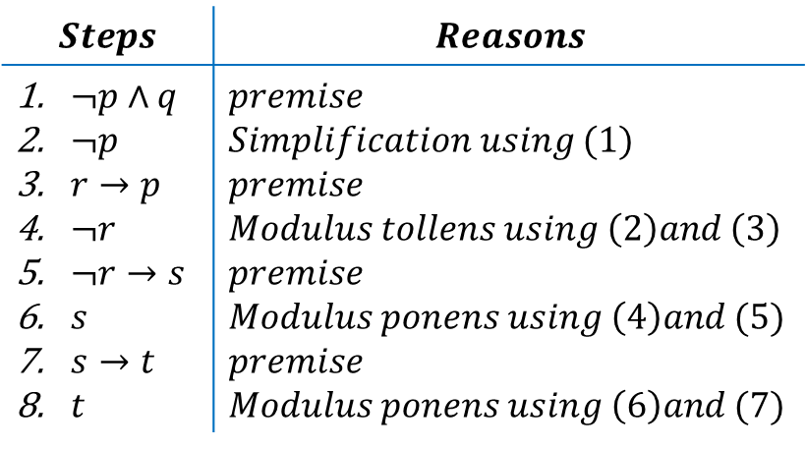
Using Rules of Inference to Build Arguments(Contd.)
We construct an argument to show that our premises lead to the desired conclusion as follows,
Thus, we can see that our premises lead to the desired conclusion.
$$Steps$$ | $$Reasons$$
$¬p∧q$ $¬p$ $r→p$ $¬r$ $¬r→s$ $s$ $s→t$ $t$ | $premise$ $Simplification using (1)$ $premise$ $Modulus tollens using \left(2\right)and \left(3\right)$ $premise$ $Modulus ponens using \left(4\right)and (5)$ $premise$ $Modulus ponens using \left(6\right)and (7)$

Slide 18
Using Rules of Inference to Build Arguments(Contd.)
Example 2:
Show that the premises
“If you send me an e-mail message, then I will ﬁnish writing the program.”
“If you do not send me an e-mail message, then I will go to sleep early.”
“If I go to sleep early, then I will wake up feeling refreshed.”
Lead to the conclusion
“If I do not ﬁnish writing the program, then I will wake up feeling refreshed.”

Slide 19
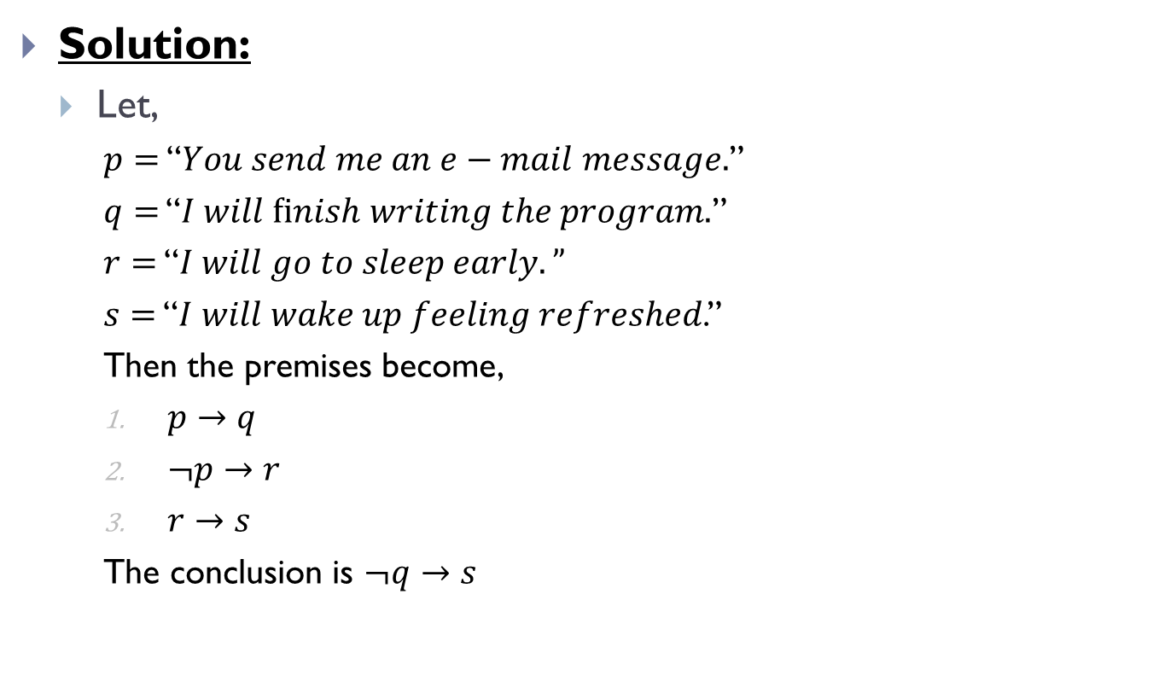
Using Rules of Inference to Build Arguments(Contd.)
Solution:
Let,
$p=$ “$You send me an e−mail message.$”
$q=$ “$I will ﬁnish writing the program.$”
$r=$ “$I will go to sleep early.”$
$s=$ “$I will wake up feeling refreshed$.”
Then the premises become,
$p→q$
$¬p→r$
$r→s$
The conclusion is $¬q→s$

Slide 20
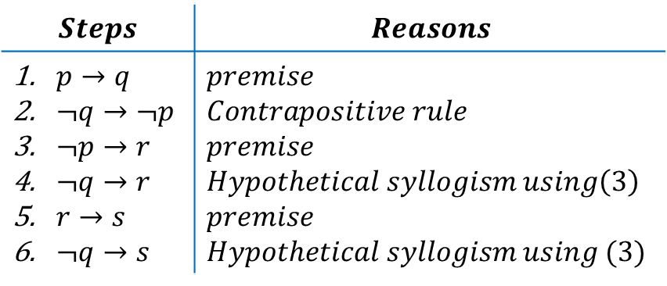
Using Rules of Inference to Build Arguments(Contd.)
We construct an argument to show that our premises lead to the desired conclusion as follows,
Thus, we can see that our premises lead to the desired conclusion.
$$Steps$$ | $$Reasons$$
$p→q$ $¬q→¬p$ $¬p→r$ $¬q→r$ $r→s$ $¬q→s$ | $premise$ $Contrapositive rule$ $premise$ $Hypothetical syllogism using\left(3\right)$ $premise$ $Hypothetical syllogism using (3)$

Slide 21
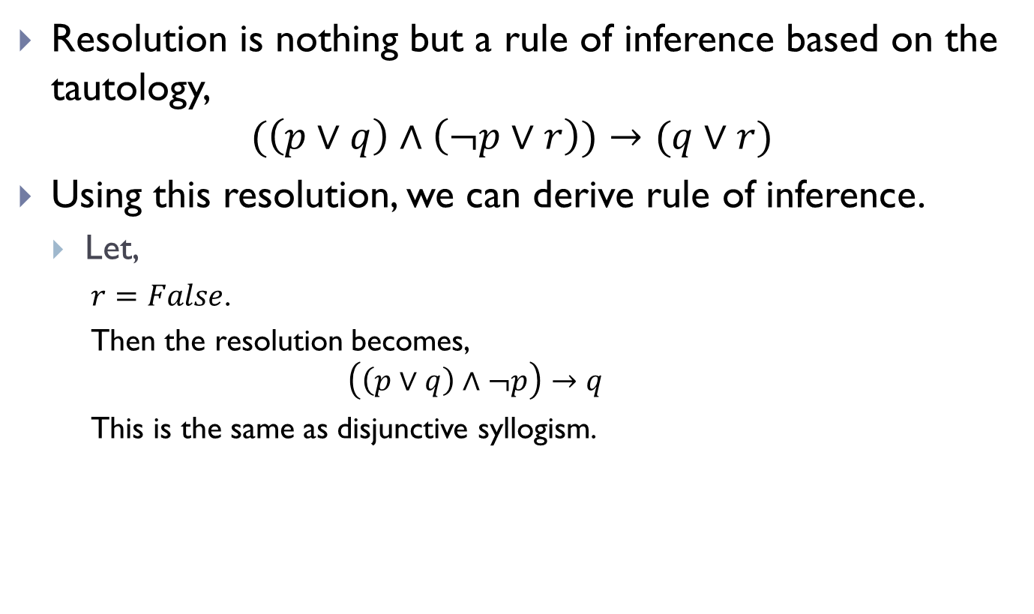
Resolution
Resolution is nothing but a rule of inference based on the tautology,
$$(\left(p∨q\right)∧\left(¬p∨r\right))→(q∨r)$$
Using this resolution, we can derive rule of inference.
Let,
$r=$ $False$.
Then the resolution becomes,
$$\left(\left(p∨q\right)∧¬p\right)→q$$
This is the same as disjunctive syllogism.

Slide 22
Resolution(Contd.)
Example 1:
Use resolution to show that the hypotheses
“Jasmine is skiing or it is not snowing”
“It is snowing or Bart is playing hockey”
Imply that
“Jasmine is skiing or Bart is playing hockey.”

Slide 23
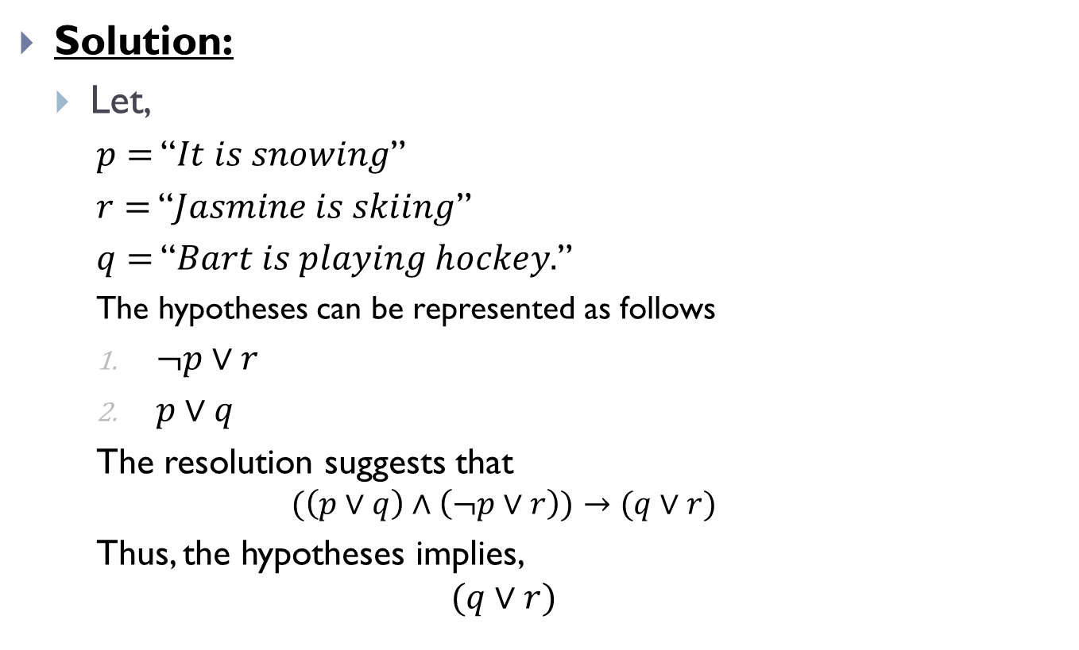
Resolution(Contd.)
Solution:
Let,
$p=$ “$It is snowing$”
$r=$ “$Jasmine is skiing$”
$q=$ “$Bart is playing hockey.$”
The hypotheses can be represented as follows
$¬p∨r$
$p∨q$
The resolution suggests that
$$(\left(p∨q\right)∧\left(¬p∨r\right))→(q∨r)$$
Thus, the hypotheses implies,
$$(q∨r)$$

Slide 24

Resolution(Contd.)
Example 2:
Show that the premises $(p ∧ q) ∨ r$and $r → s$imply the conclusion $p ∨ s.$

Slide 25

Resolution(Contd.)
Solution:
We can rewrite the premises $(p ∧ q) ∨ r$as two clauses, $p ∨ r$and $q ∨ r.$We can also replace $r → s$by the equivalent clause $¬r ∨ s.$Using the two clauses $p ∨ r$and $¬r ∨ s$, we can use resolution to conclude $p ∨ s.$

Slide 26
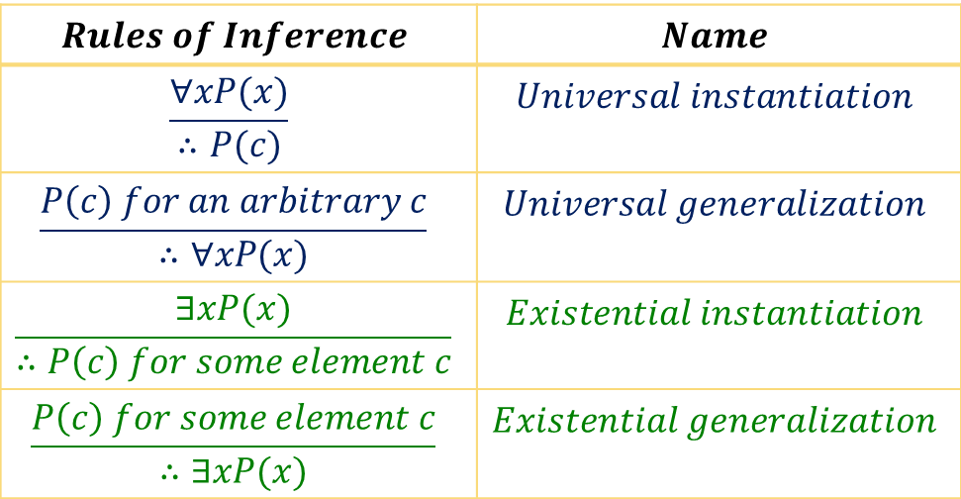
Rules of Inference for Quantifiers
Like the rules of inference for propositions, we now we see the rules of inference for quantified statements.
$$Rules of Inference$$ | $$Name$$
$$\frac{∀xP(x)}{∴P(c)}$$ | $$Universal instantiation$$
$$\frac{P\left(c\right) for an arbitrary c}{∴∀xP(x)}$$ | $$Universal generalization$$
$$\frac{∃xP(x)}{∴P\left(c\right) for some element c}$$ | $$Existential instantiation$$
$$\frac{P\left(c\right) for some element c}{∴∃xP(x)}$$ | $$Existential generalization$$

Slide 27
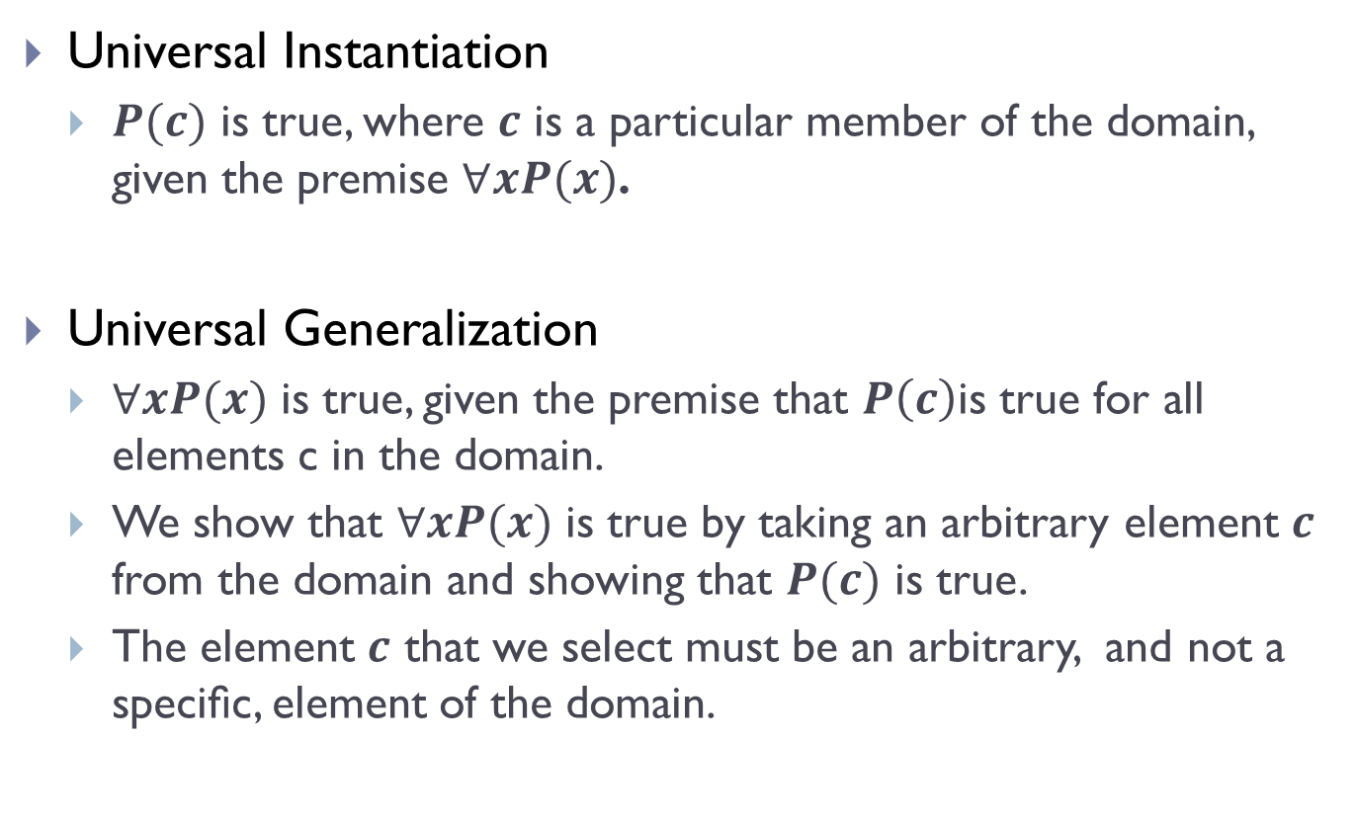
Rules of Inference for Quantifiers(Contd.)
Universal Instantiation
$P(c)$ is true, where $c$ is a particular member of the domain, given the premise $∀xP(x)$.
Universal Generalization
$∀xP(x)$ is true, given the premise that $P\left(c\right)$is true for all elements c in the domain.
We show that $∀xP(x)$ is true by taking an arbitrary element $c$ from the domain and showing that $P(c)$ is true.
The element $c$ that we select must be an arbitrary, and not a speciﬁc, element of the domain.

Slide 28
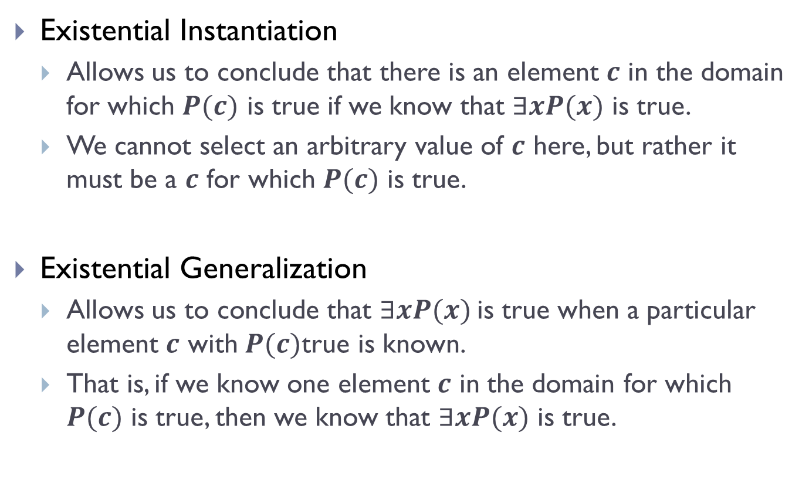
Rules of Inference for Quantifiers(Contd.)
Existential Instantiation
Allows us to conclude that there is an element $c$ in the domain for which $P(c)$ is true if we know that $∃xP(x)$ is true.
We cannot select an arbitrary value of $c$ here, but rather it must be a $c$ for which $P(c)$ is true.
Existential Generalization
Allows us to conclude that $∃xP(x)$is true when a particular element $c$ with $P(c)$true is known.
That is, if we know one element $c$ in the domain for which $P(c)$ is true, then we know that $∃xP(x)$ is true.

Slide 29
Rules of Inference for Quantifiers(Contd.)
Example 1:
Show that the premises
“Everyone in this discrete mathematics class has taken a course in computer science”
“Marla is a student in this class”
Imply the conclusion
“Marla has taken a course in computer science.”

Slide 30
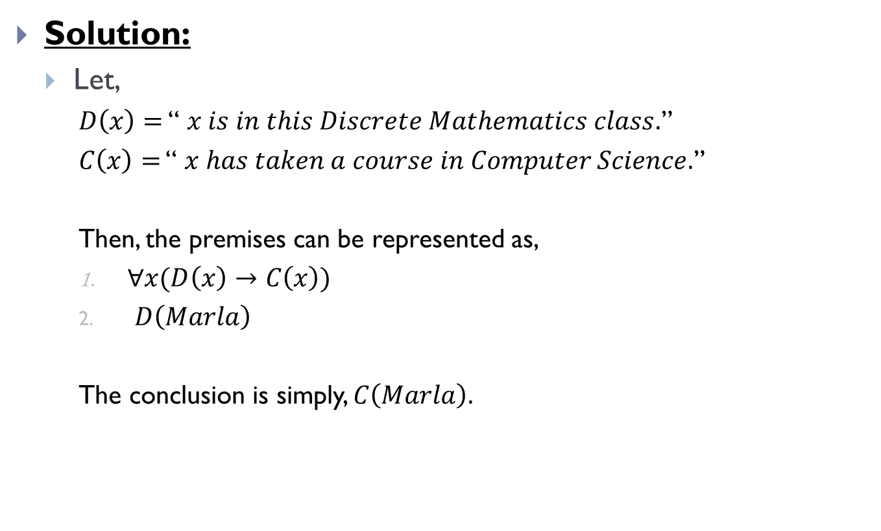
Rules of Inference for Quantifiers(Contd.)
Solution:
Let,
$D\left(x\right)=$ “ $x is in this Discrete Mathematics class.$”
$C\left(x\right)=$ “ $x has taken a course in Computer Science.$”
Then, the premises can be represented as,
$∀x(D\left(x\right)→C\left(x\right))$
$D\left(Marla\right)$
The conclusion is simply, $C\left(Marla\right).$

Slide 31
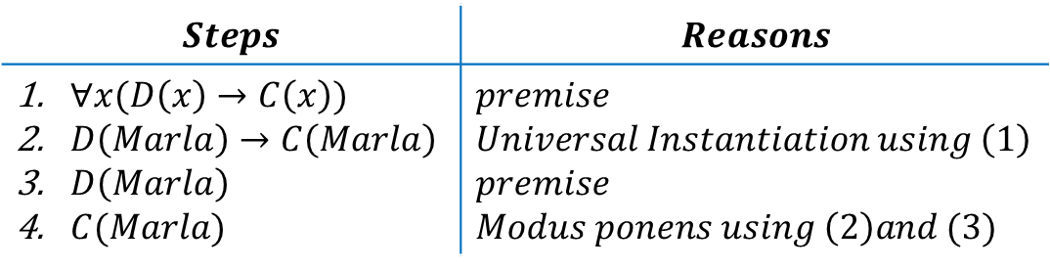
Rules of Inference for Quantifiers(Contd.)
We construct an argument to show that our premises lead to the desired conclusion as follows,
Thus, we can see that our premises lead to the desired conclusion.
$$Steps$$ | $$Reasons$$
$∀x(D\left(x\right)→C\left(x\right))$ $D\left(Marla\right)→C\left(Marla\right)$ $D\left(Marla\right)$ $C(Marla)$ | $premise$ $Universal Instantiation using \left(1\right)$ $premise$ $Modus ponens using \left(2\right)and (3)$

Slide 32
Rules of Inference for Quantifiers(Contd.)
Example 2:
Show that the premises
“A student in this class has not read the book”
“Everyone in this class passed the ﬁrst exam”
Imply the conclusion
“Someone who passed the ﬁrst exam has not read the book.”

Slide 33
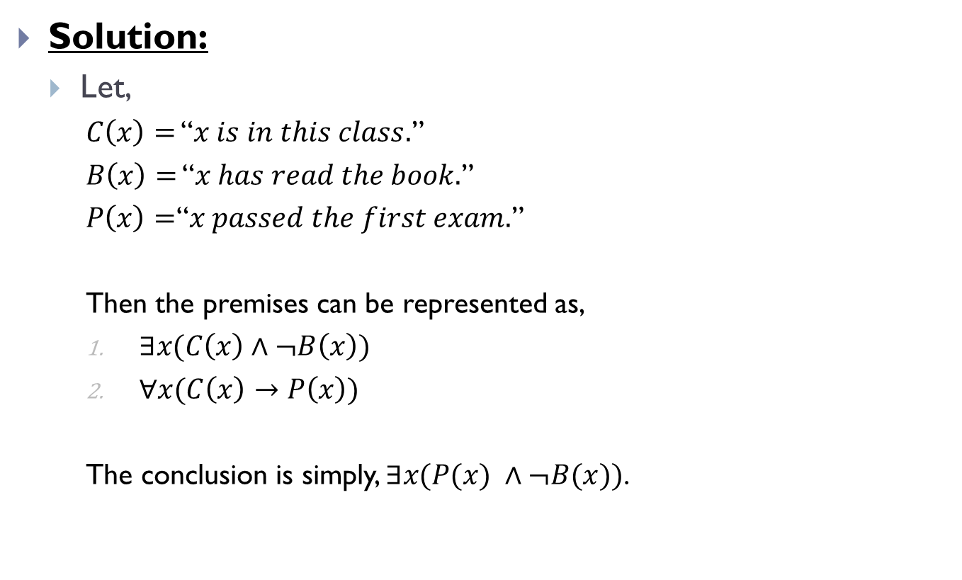
Rules of Inference for Quantifiers(Contd.)
Solution:
Let,
$C\left(x\right)=$ “$x is in this class.$”
$B\left(x\right)=$ “$x has read the book.$”
$P\left(x\right)=$“$x passed the first exam.$”
Then the premises can be represented as,
$∃x(C\left(x\right)∧¬B\left(x\right))$
$∀x(C\left(x\right)→P\left(x\right))$
The conclusion is simply, $∃x(P(x) ∧¬B(x))$.

Slide 34
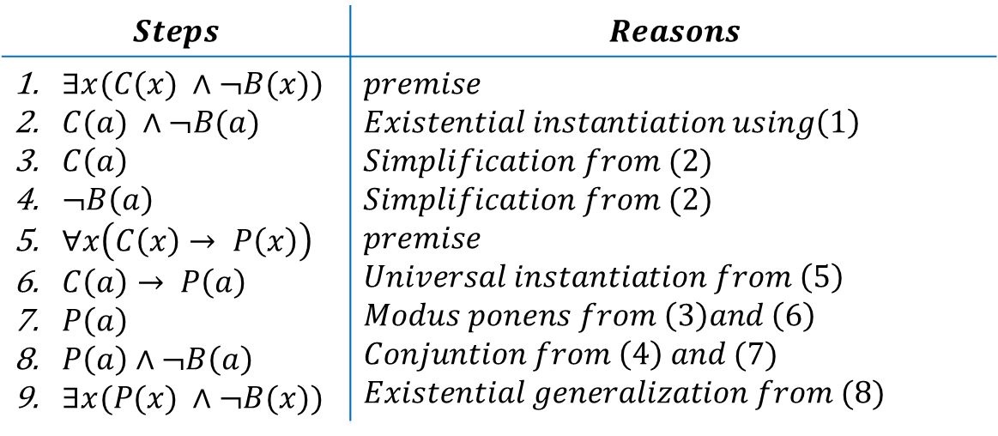
Rules of Inference for Quantifiers(Contd.)
We construct an argument to show that our premises lead to the desired conclusion as follows,
Thus, we can see that our premises lead to the desired conclusion.
$$Steps$$ | $$Reasons$$
$∃x(C(x) ∧¬B(x))$ $C(a) ∧¬B(a)$ $C\left(a\right)$ $¬B\left(a\right)$ $∀x\left(C\left(x\right)→ P\left(x\right)\right)$ $C\left(a\right)→ P\left(a\right)$ $P\left(a\right)$ $P\left(a\right)∧¬B\left(a\right)$ $∃x(P(x) ∧¬B(x))$ | $premise$ $Existential instantiation using\left(1\right)$ $Simplification from (2)$ $Simplification from (2)$ $premise$ $Universal instantiation from \left(5\right)$ $Modus ponens from \left(3\right)and \left(6\right)$ $Conjuntion from \left(4\right) and (7)$ $Existential generalization from (8)$

Slide 35
THE END

